Slide 1
Quanvolutional neural network
14/2/2023
https://arxiv.org/abs/1904.04767
https://arxiv.org/abs/2108.00661.pdf

Slide 2
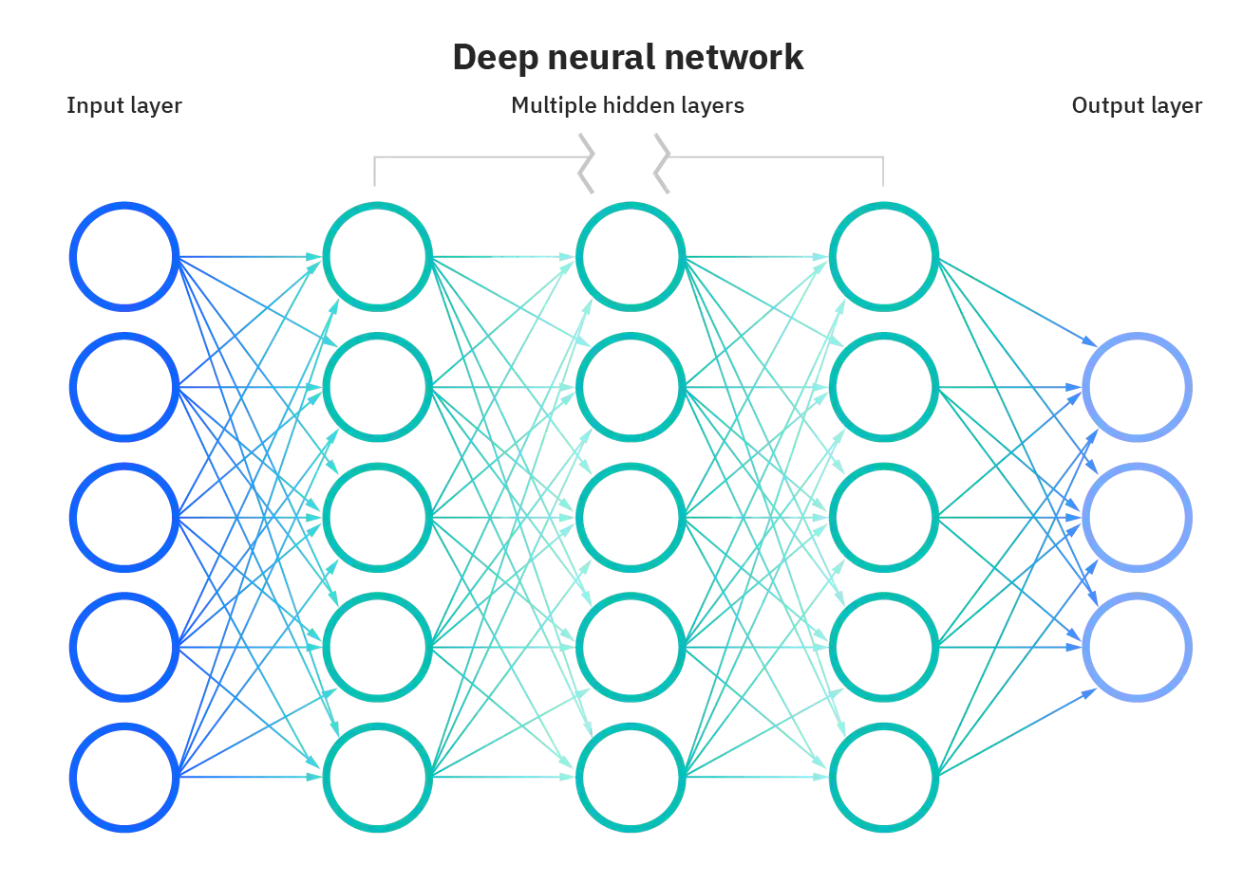
Neural network

Slide 3
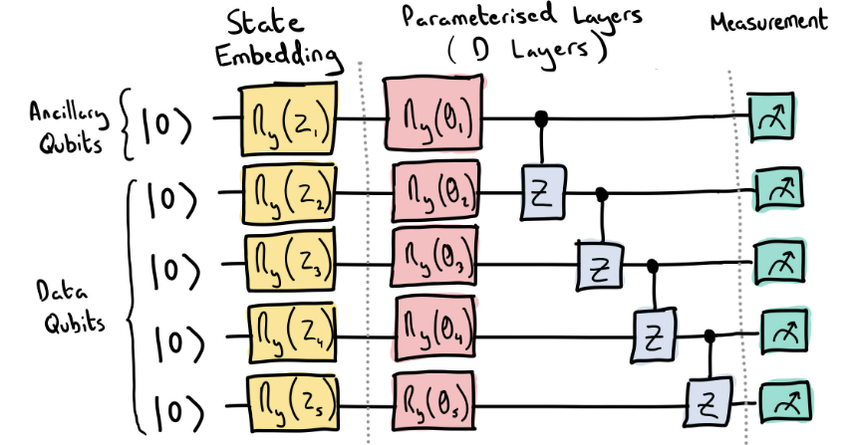
Quantum neural network

Slide 4
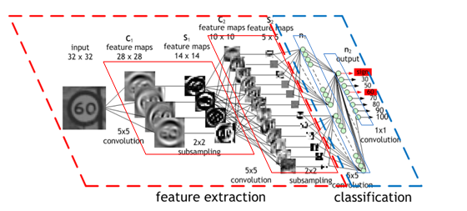
Convolutional neural network

Slide 5
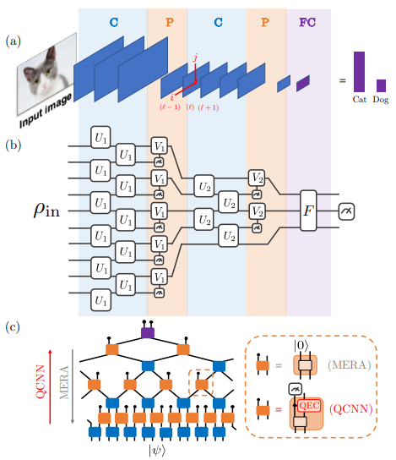
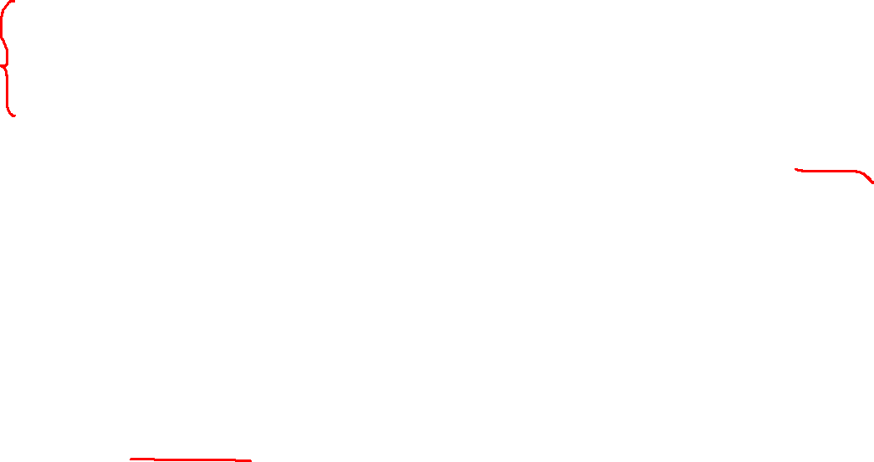
Quantum convolutional neural network
Absence of Barren Plateaus in Quantum Convolutional Neural Networks, PRX, 11,041011 (2021)

Slide 6
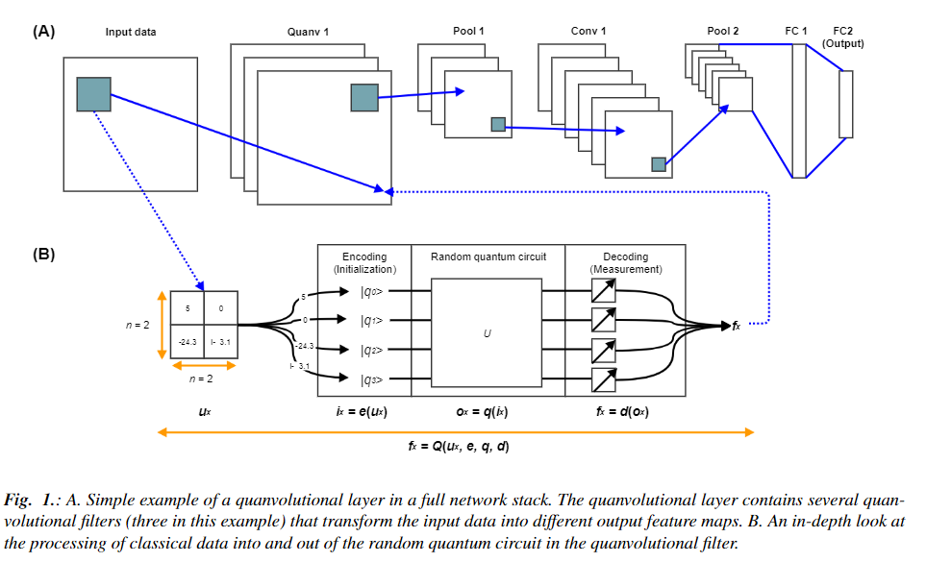
Overall structural

Slide 7
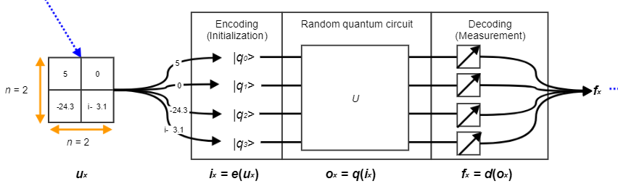
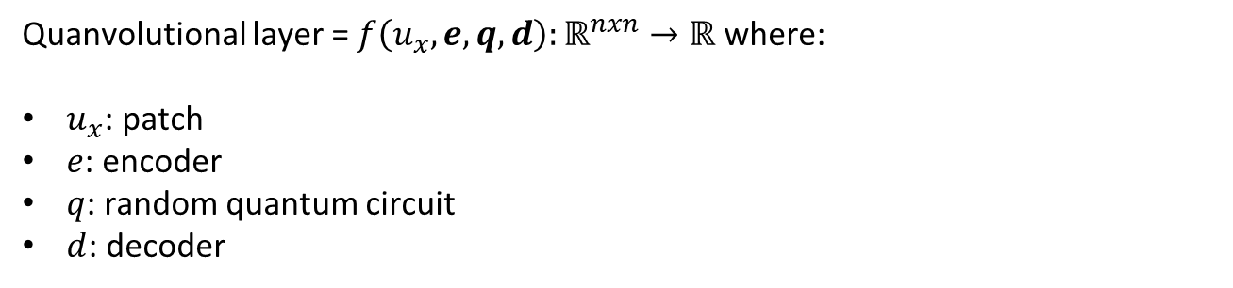

Quanvolutional layer
Quanvolutional layer = $f\left(u_{x},e,q,d\right):ℝ^{nxn}→ℝ$ where:
$u_{x}$: patch
$e$: encoder
$q$: random quantum circuit
$d$: decoder

Slide 8

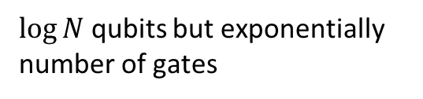
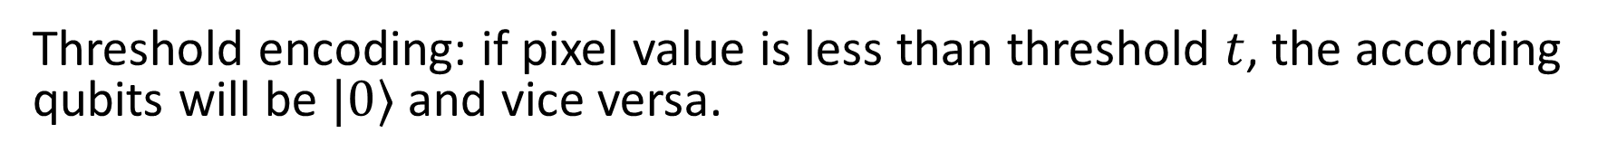
Encoding & Decoding
$\log{N}$ qubits but exponentially number of gates
$e:ℝ^{nxn}→|ψ⟩$
Amplitude encoding
$N$ qubit, linear number of gate
Threshold encoding: if pixel value is less than threshold $t$, the according qubits will be $|0⟩$ and vice versa.
$d:\left|ψ\right\rangle →ℝ$

Slide 9
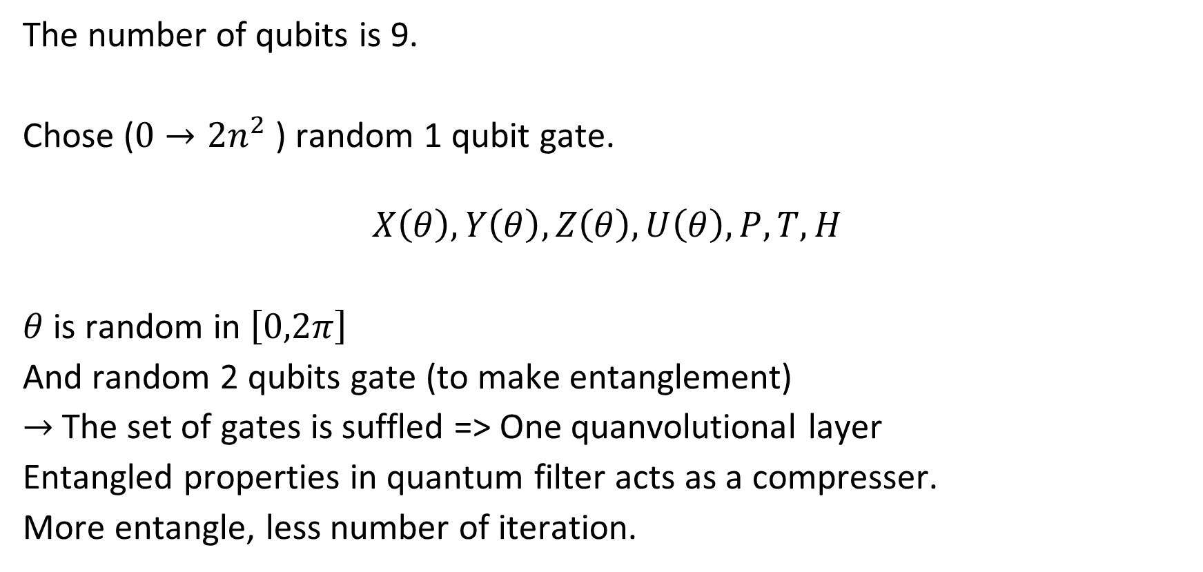
Quantum circuit
The number of qubits is 9.
Chose ($0→2n^{2}$) random 1 qubit gate.
$$X\left(θ\right),Y\left(θ\right),Z\left(θ\right),U\left(θ\right),P,T,H$$
$θ$ is random in $\left[0,2π\right]$
And random 2 qubits gate (to make entanglement)
$→$ The set of gates is suffled => One quanvolutional layer
Entangled properties in quantum filter acts as a compresser.
More entangle, less number of iteration.

Slide 10
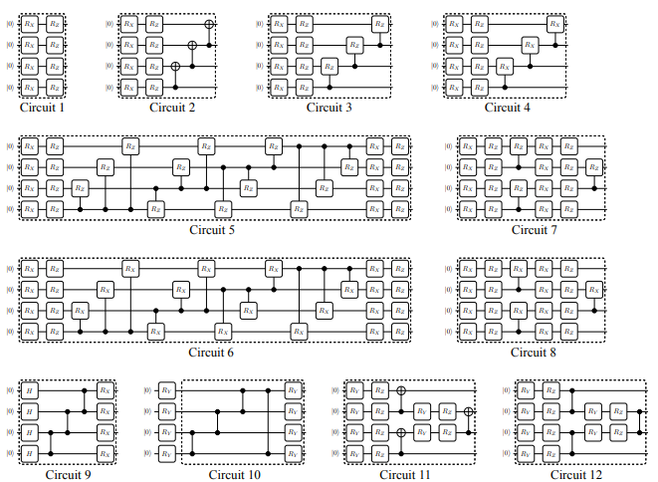
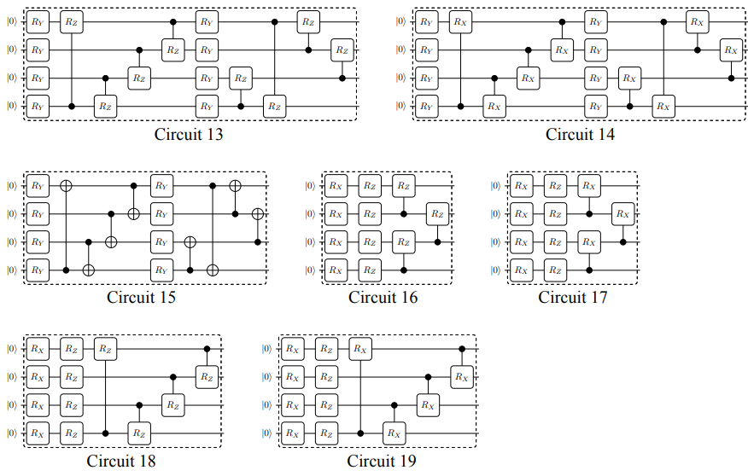
Quantum circuit
Expressibility and entangling capability of parameterized quantum circuits for hybrid quantum-classical algorithms

Slide 11
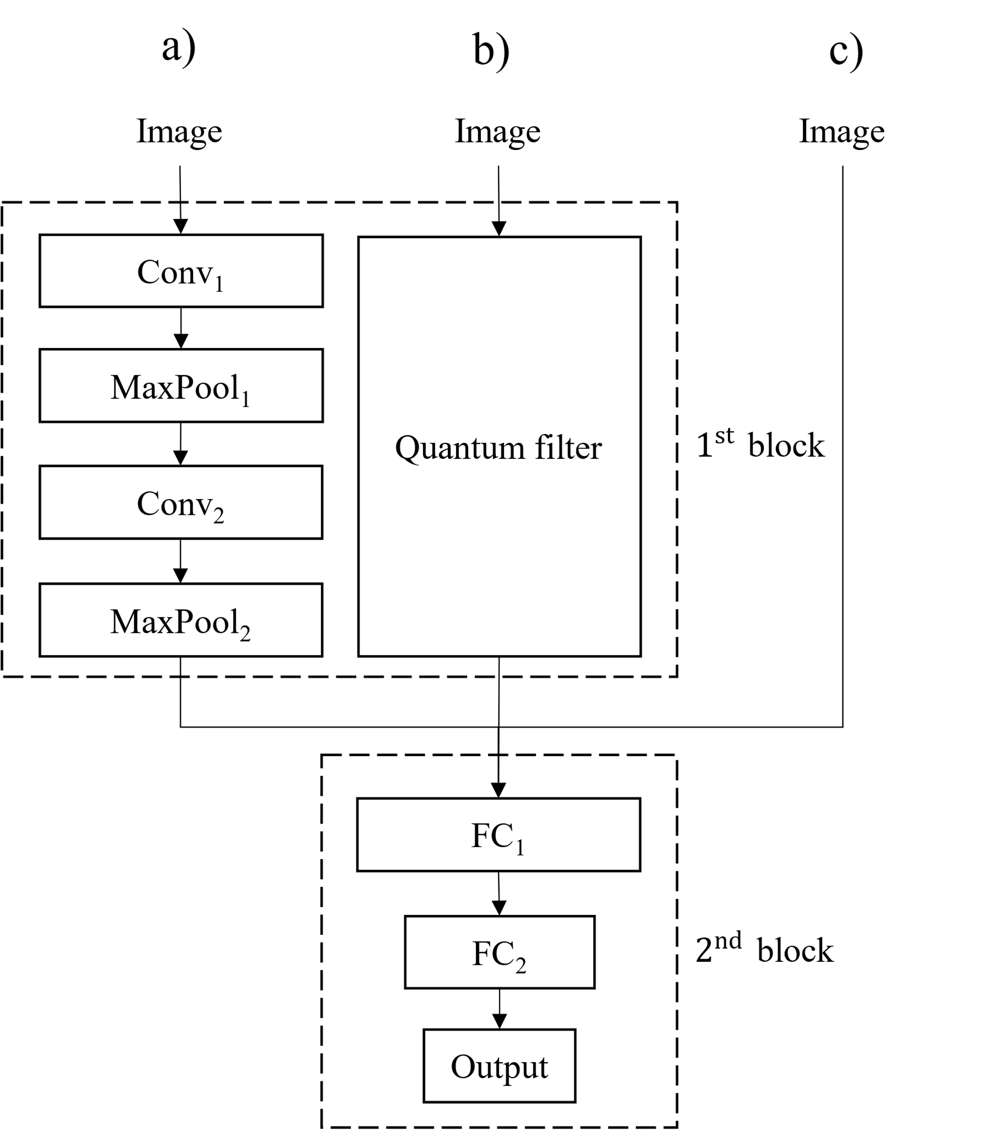
Model
Model H1: Lenet
Model H2: Hybrid
Model H3: Without quanv

Slide 12
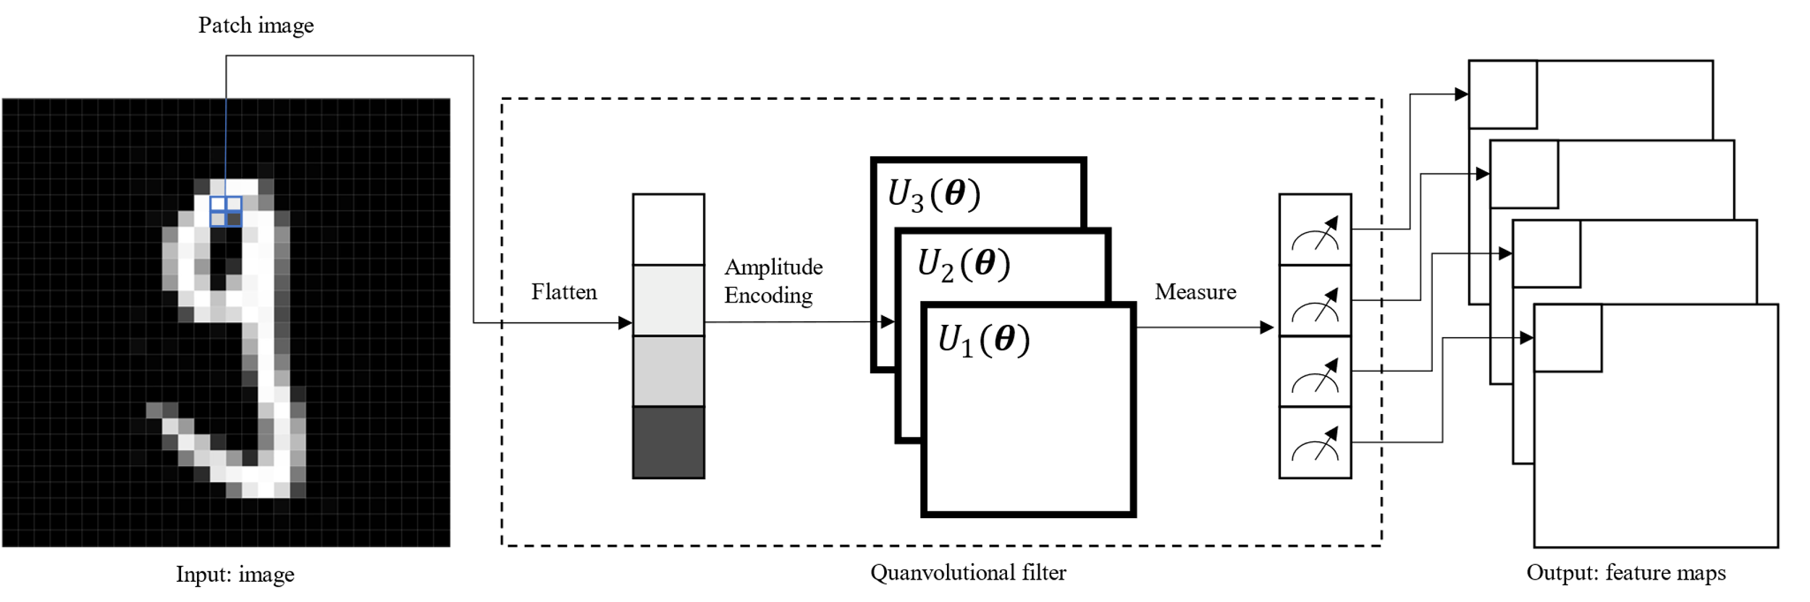
Scheme

Slide 13
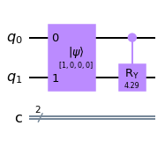
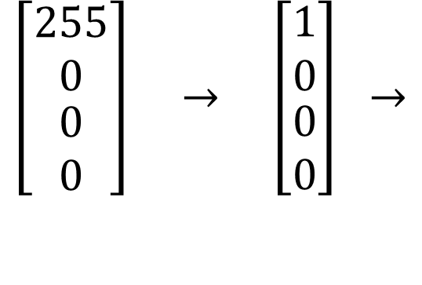
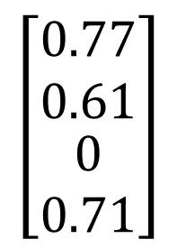


Quanv layer / filter
Random $R_{Y}$ gate
$$\left[\begin{matrix}\begin{matrix}0.77 \\ 0.61\end{matrix} \\ 0 \\ 0.71\end{matrix}\right]$$
$$\left[\begin{matrix}\begin{matrix}255 \\ 0\end{matrix} \\ 0 \\ 0\end{matrix}\right] → \left[\begin{matrix}\begin{matrix}1 \\ 0\end{matrix} \\ 0 \\ 0\end{matrix}\right] →$$
$$→$$
Normalize
Load
Measure
2 x 2 filter
Probability vector

Slide 14
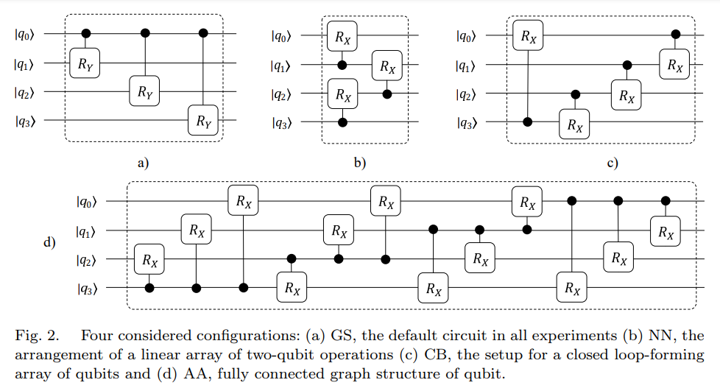
Circuit

Slide 15
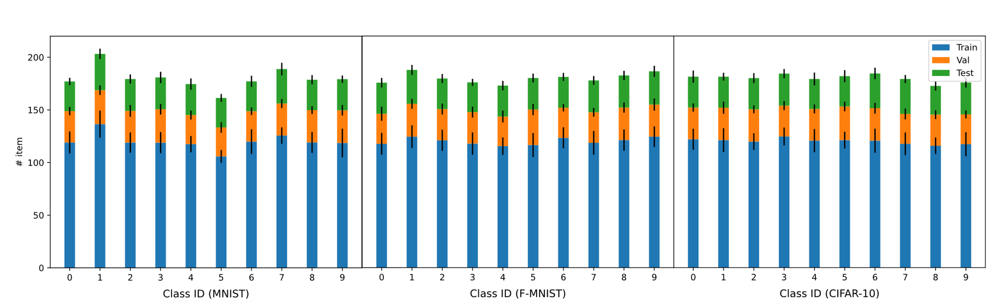
Dataset
28x28 gray MNIST and FMNIST (60k train, 10k test)
32x32 gray CIFAR-10

Slide 16
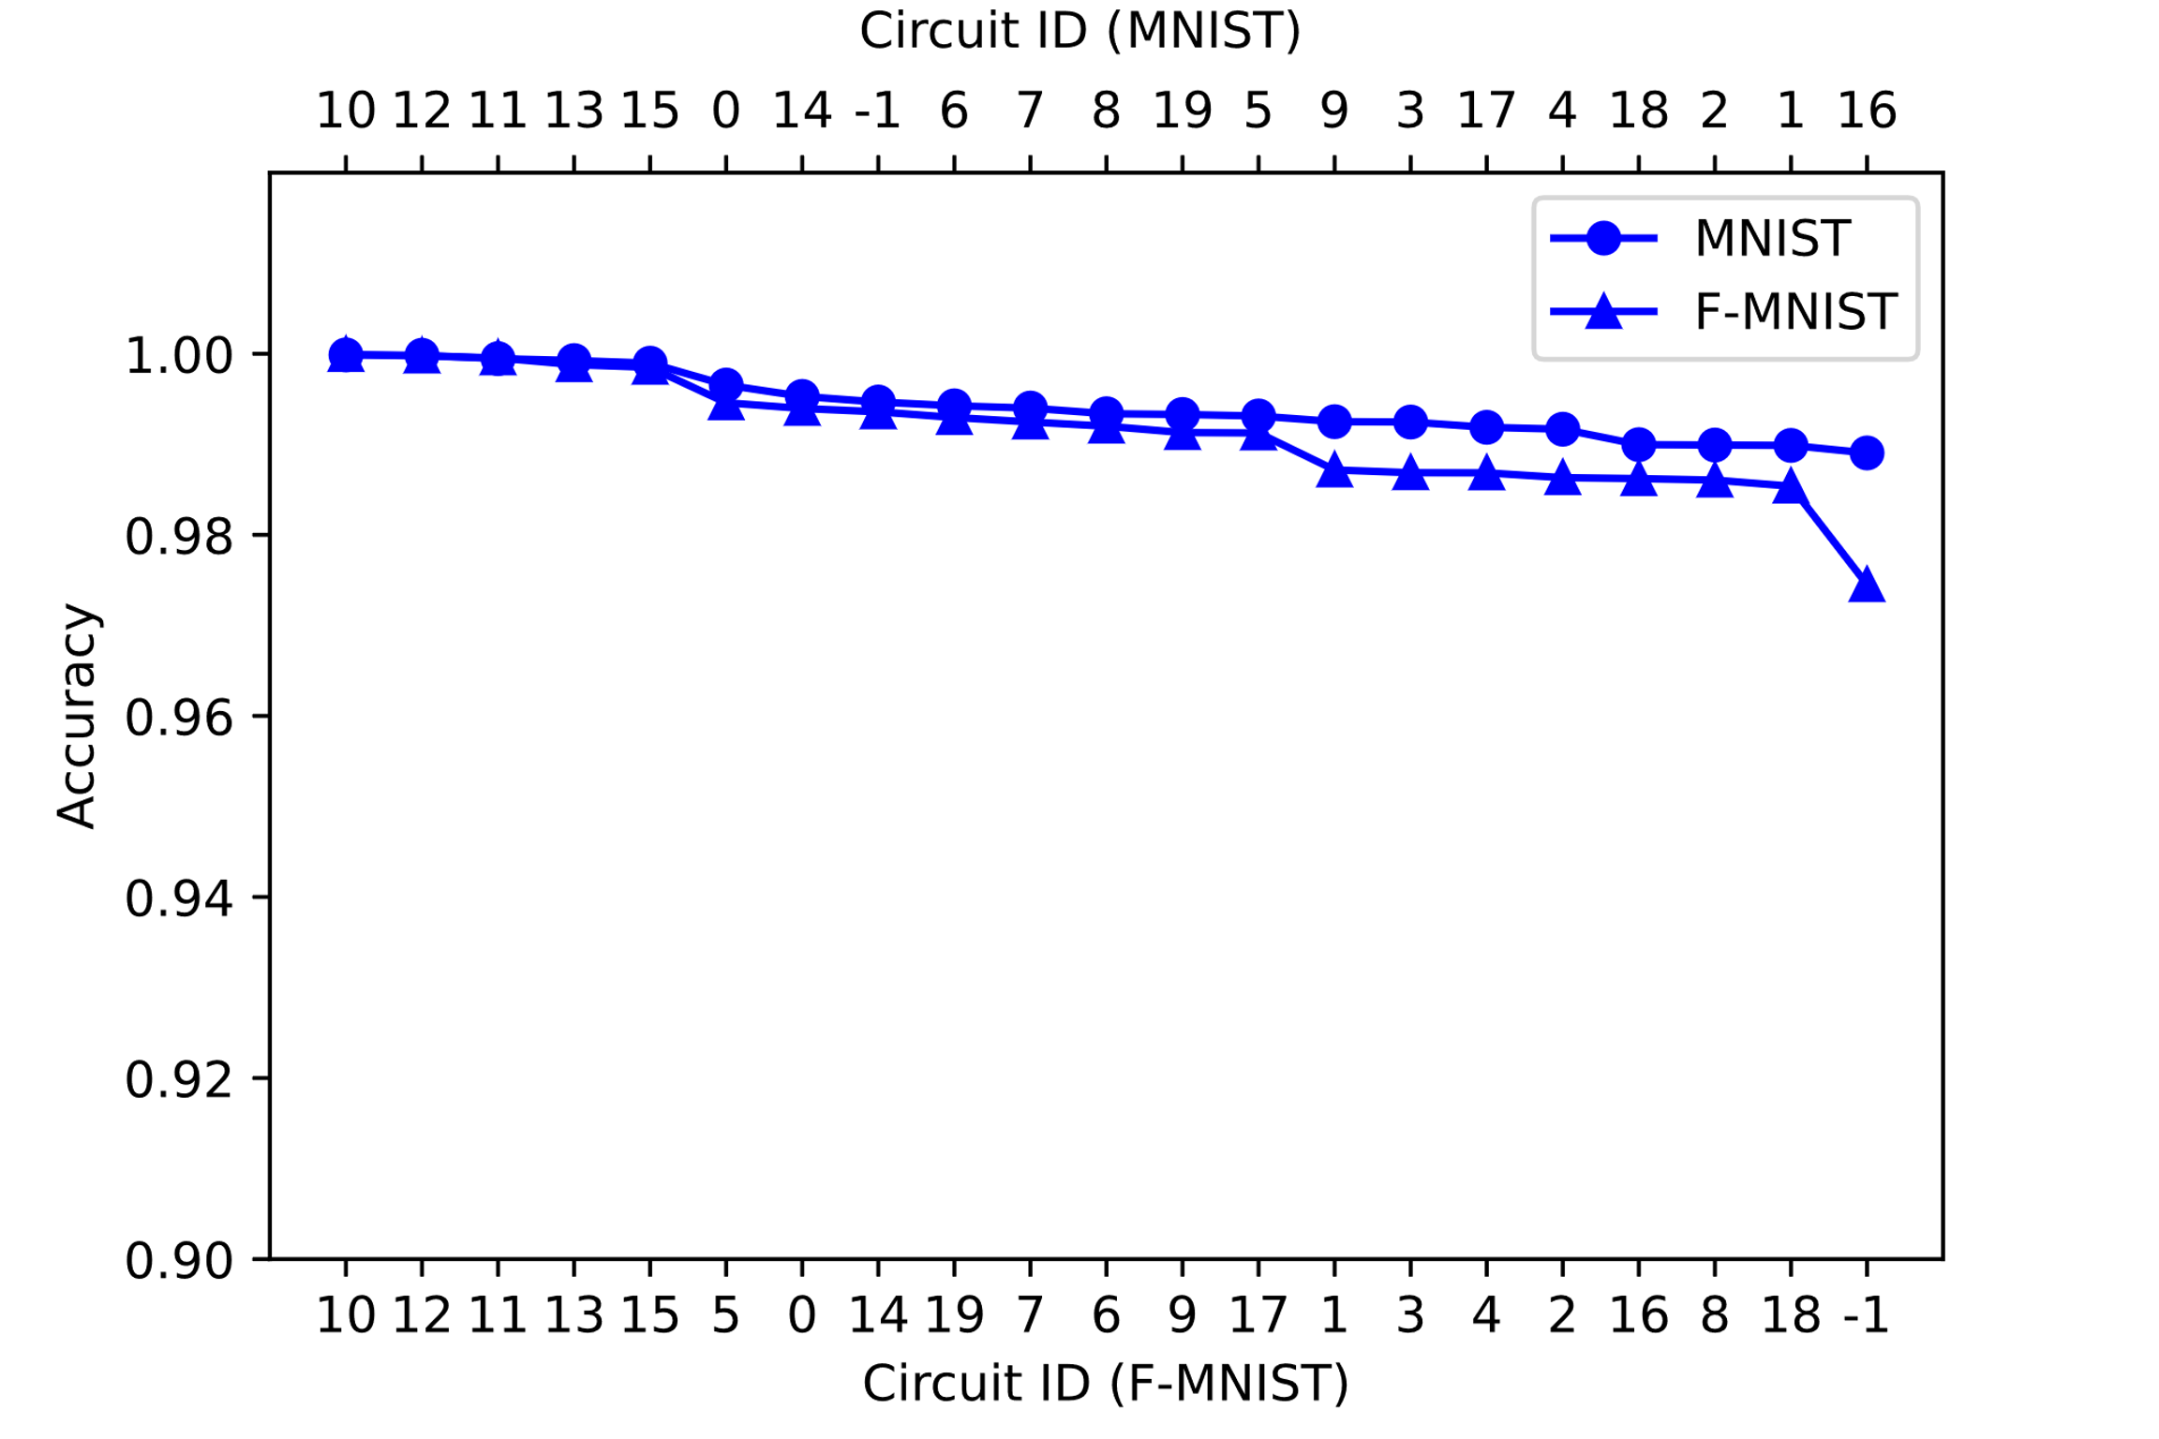
1. Different between quanv filters (4x4, 4 filter)

Slide 17
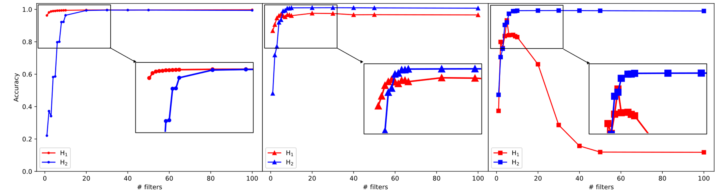
2. Different between number of filter
Train and test on MNIST
Train and test on MNIST Fashion
Train and test on CIFAR-10
From 1 to 100 filters

Slide 18
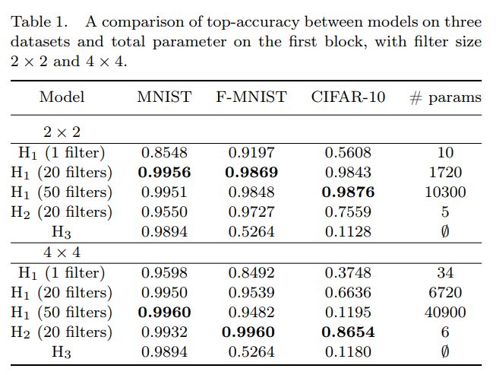
3. Compare #. pram

Slide 19
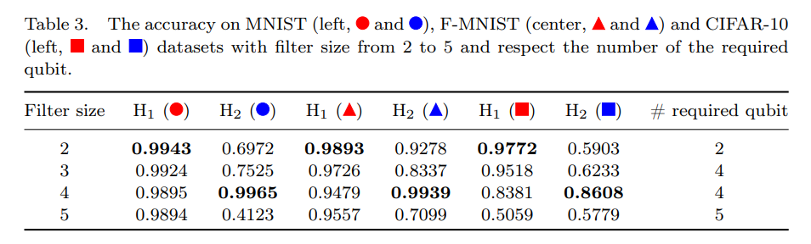
4. Filter size

Slide 20

Advanced of quanv filter
We increase the number of quanv filter by adding more random circuit.
One random circuit $n$ qubit is equivalent to $2^{n}$ filter $2^{n}x2^{n}$. That means we can increase the number of quanv filter rapidly.

Slide 21

Quantum advantages
Quantum computers can access kernel functions in highdimensional Hilbert spaces much more efficiently than classical computers.
$→$ Coverage faster

Slide 22
Disadvatanges
Number of measurements
Number of quanvolutional filters

Slide 23
Future works
Test on another dataset and deeper QNN.
Make quanvolutional layer trainable or change by time by the evolutional / genetic algorithm. => Use QNG in quanvolutional layer

Slide 24
1. Something about quanv filter

